Slide 1



12.A Describing Networking Concepts
describe fundamental concepts of network
addressing and routing for a server

Slide 2

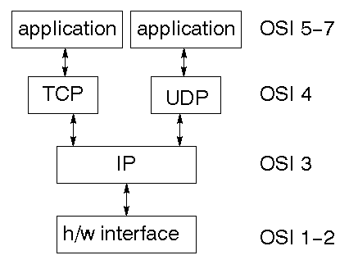
TCP/IP NETWORK MODEL
a simplified, four-layered set of abstractions that describes how
different protocols interoperate in order for computers to send traffic from one machine to another
over the Internet.

Slide 3


4 Application
Each application has specifications for communication so that clients and servers may
communicate across platforms. Common protocols include SSH (remote login), HTTPS (secure web), NFS or CIFS (file sharing), and SMTP (electronic mail delivery).

Slide 4

3 Transport
Application protocols use TCP or UDP ports. A
list of well-known and registered ports can be found in the /etc/services file.
the combination of the service port and IP address forms a socket.

Slide 5
2 Internet
or network layer, carries data from the source host to the destination host. The IPv4 and IPv6 protocols are Internet layer protocols. Each host has an IP address and a prefix
used to determine network addresses.
Routers are used to connect networks.

Slide 6
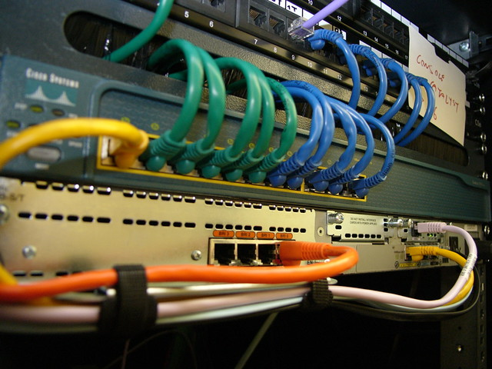
1 link
The most common types of networks are wired Ethernet (802.3) and wireless WLAN (802.11). Each physical device has a hardware address (MAC) which is used to identify the destination of packets on the local network segment.

Slide 7
DESCRIBING NETWORK INTERFACE NAMES
Each network port on a system has a name,

Slide 8
Older versions
eth0, eth1, and eth2
the PCIe standard does not guarantee the order in which PCIe devices will be detected on boot,

Slide 9
recent versions
names of network interfaces are assigned based on information from the firmware,
Network interface names start with the type of interface:
Ethernet interfaces begin with en
WLAN interfaces begin with wl
WWAN interfaces begin with ww

Slide 10
Rest of names
location of the device in the PCI topology
1
oN indicates that this is an on-board device
2
sN indicates that this device is in PCI hotplug
3
pMsN indicates that this is a PCI device on bus M in slot N.

Slide 11
IPv4 Addresses
172. 17. 5. 3
10101100.00010001.00000101.00000011
32-bit number, normally expressed in decimal as four 8-bit octets ranging in value from 0 to 255, separated by dots.

Slide 12
IPv4 Addresses
Network part host part
172. 17. 5. 3
10101100.00010001.00000101.00000011
The address is divided into two parts: the network part and the host part.

Slide 13
netmask
Netmask
255. 255. 0. 0
11111111.11111111.00000000.00000000
The netmask indicates how many bits of the IPv4 address belong
to the subnet.
The more bits available for the host part, the more hosts can be on the subnet

Slide 14
Netmask syntax
Netmask
255. 255. 0. 0
11111111.11111111.00000000.00000000
The older syntax for a netmask uses 24 bits for the network part and reads 255.255.255.0.
A newer syntax, called CIDR notation, specifies a network prefix of /24

Slide 15
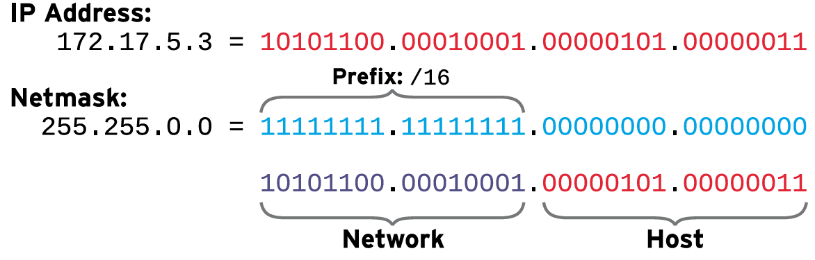


Slide 16
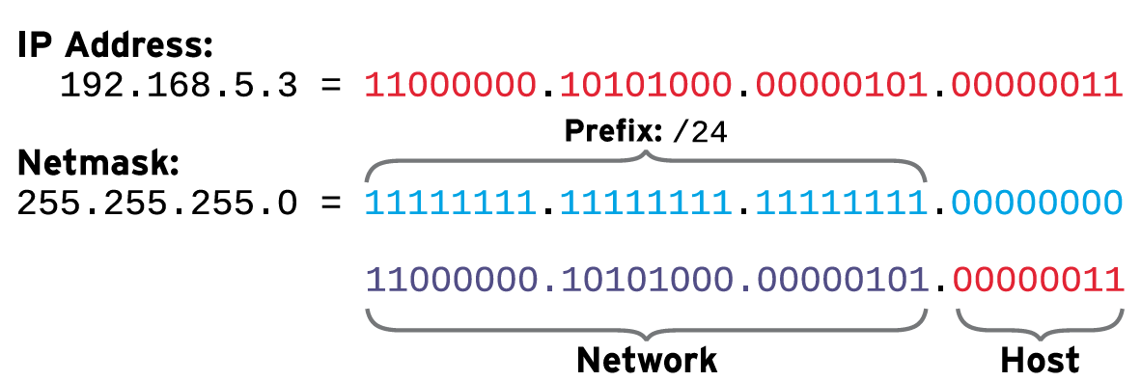

Slide 17
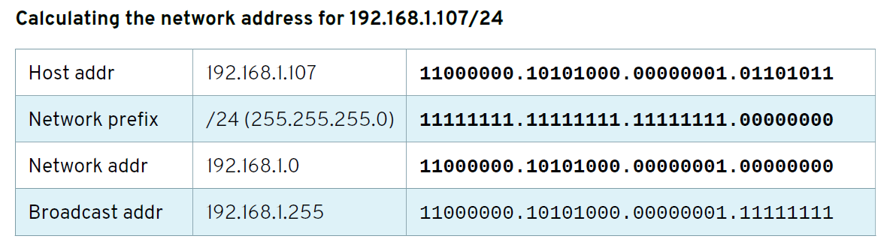

Slide 18
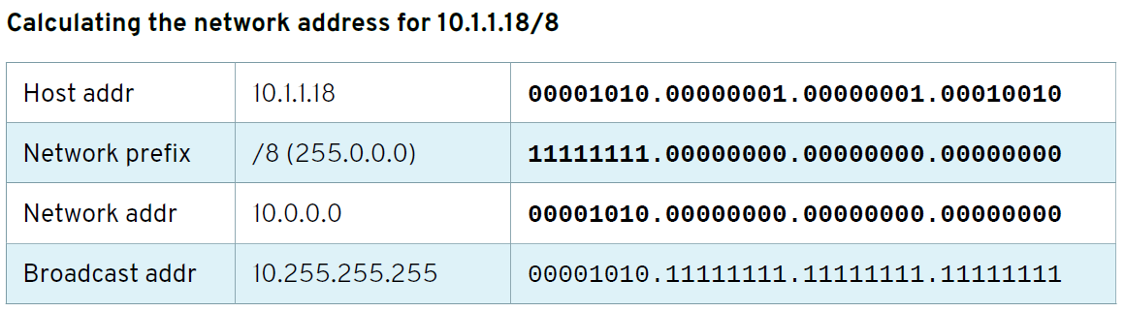

Slide 19
localhost
The special address 127.0.0.1 always points to the local system (“localhost”), and the network
127.0.0.0/8 belongs to the local system, so that it can talk to itself using network protocols.

Slide 20
routing
network traffic needs to move from host to host and network to network
Each host has a routing table
routing table entry lists a destination network, which interface to use when sending traffic,
a default route to the entire IPv4 Internet: 0.0.0.0/0.
The router forwards the traffic based on its own routing table

Slide 21
Address and Route Configuration
IPv4 network settings at boot time from a DHCP server
you can configure a server to use a static network configuration

Slide 22
IPv6 Addresses
2001:0db8:0000:0010:0000:0000:0000:0001
used in parallel with IPv4 in a dual-stack model.
128-bit number, normally expressed as 8 colon-separated groups of
4 hexadecimal nibbles (half-bytes). Each nibble represents four bits of the IPv6 address, so each
group represents 16 bits of the IPv6 address

Slide 23
Remove leading zeros
2001:db8:0:10:0:0:0:1

Slide 24
Combine
zeros
2001:db8:0:10::1

Slide 25
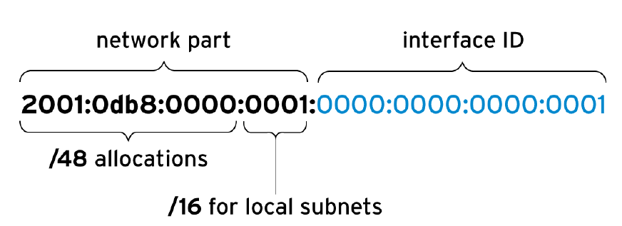
IPv6 Subnetting
divided into two parts: the network prefix and interface ID.
IPv6 has a standard subnet mask, which is used for almost all normal addresses, /64.

Slide 26
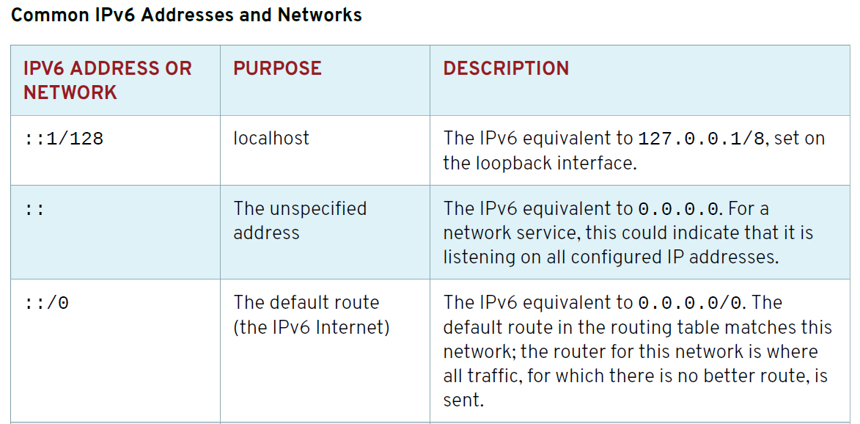

Slide 27
HOST NAMES AND IP ADDRESSES
Linux has a number of mechanisms to map a host name to an IP address, collectively called
name resolution
set a static entry for each name in the /etc/hosts file on each system

Slide 28
HOST NAMES AND IP ADDRESSES
you can look up the address for a host name (or a host name from an address) from a network service called the Domain Name System (DNS)
In order for name service to work, a host needs
to be pointed at a nameserver
This is typically configured through DHCP or a static setting in a file called /etc/resolv.conf.

